Slide 1
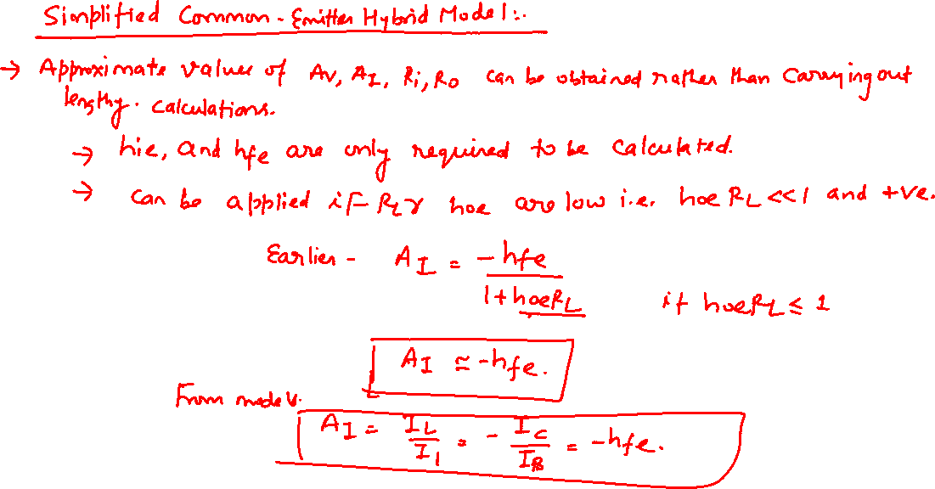

Slide 2
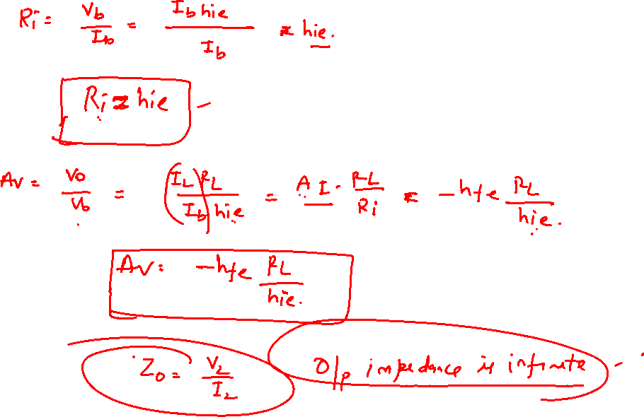

Slide 3
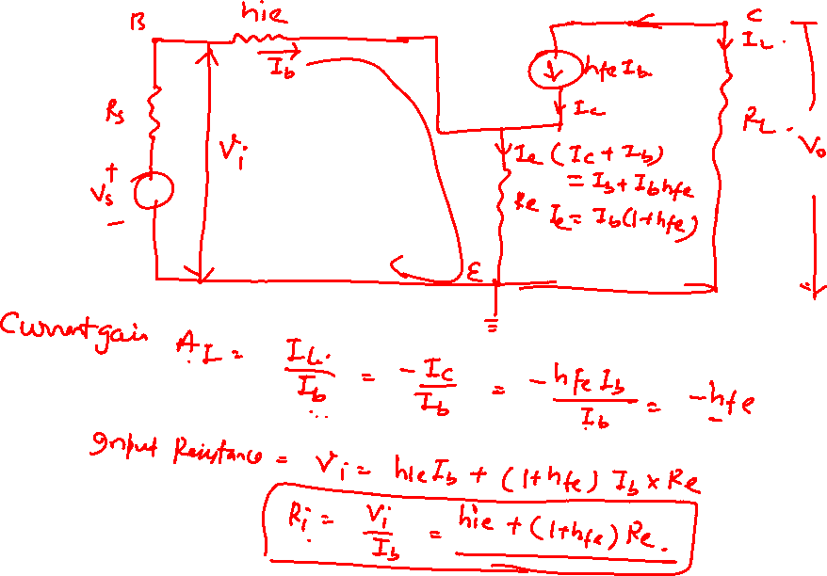

Slide 4
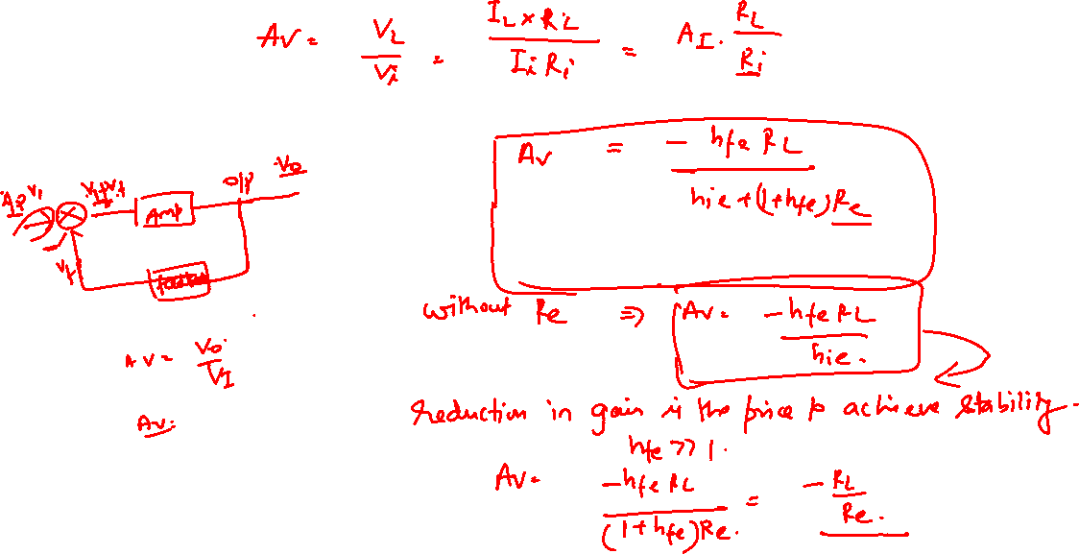

Slide 5
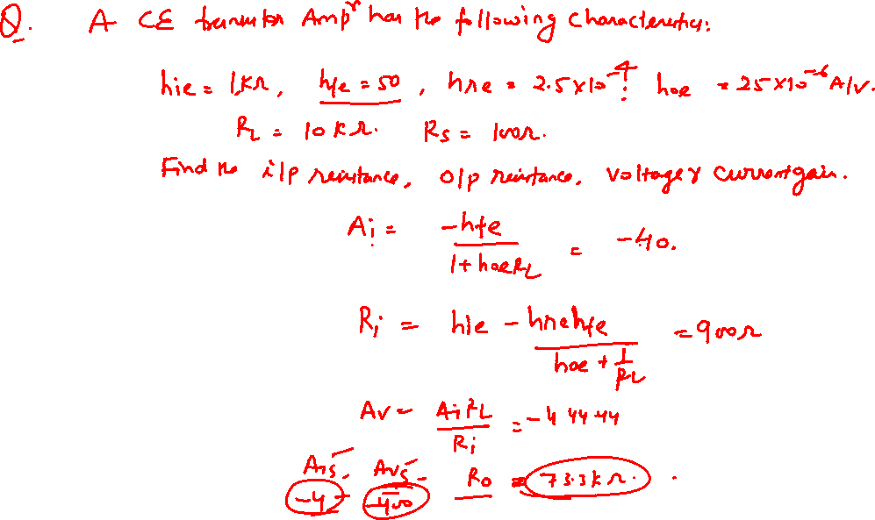


Slide 6
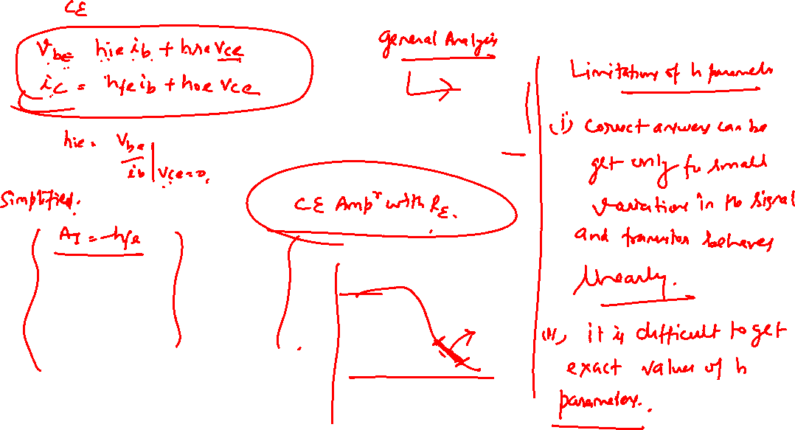

Slide 7
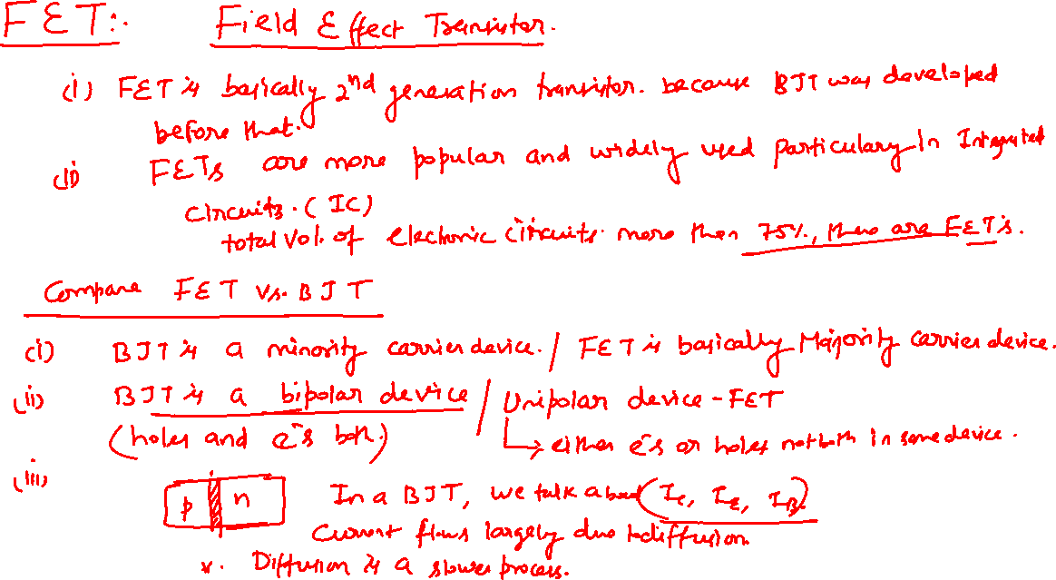

Slide 8
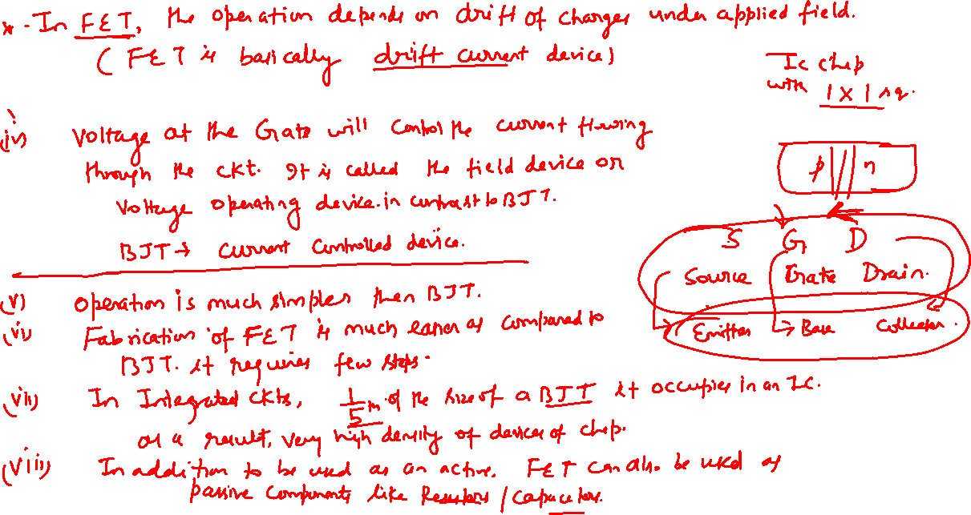


Slide 9
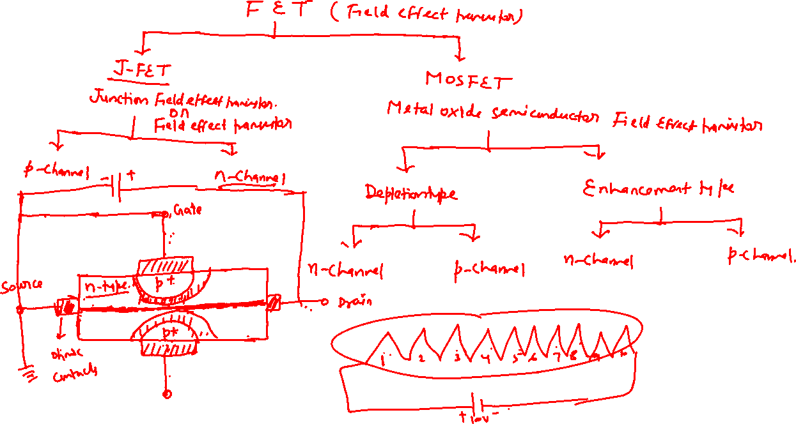

Slide 10
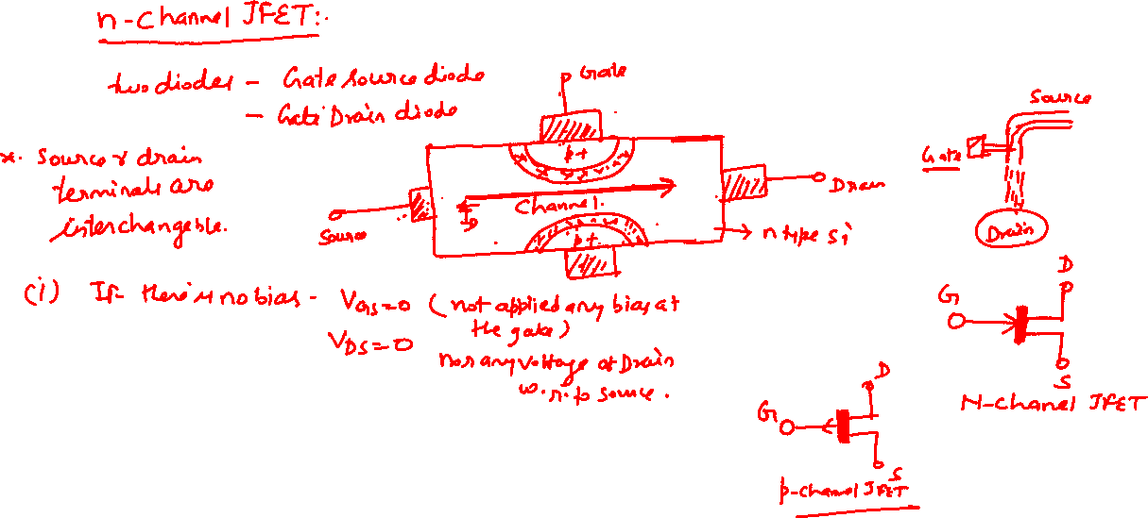


Slide 11
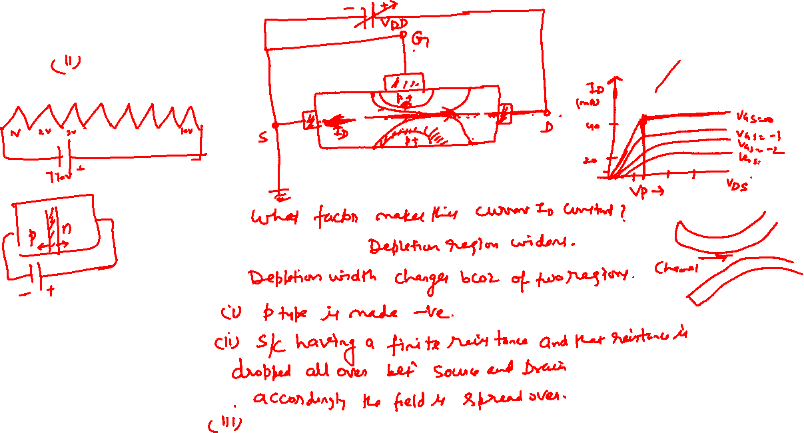
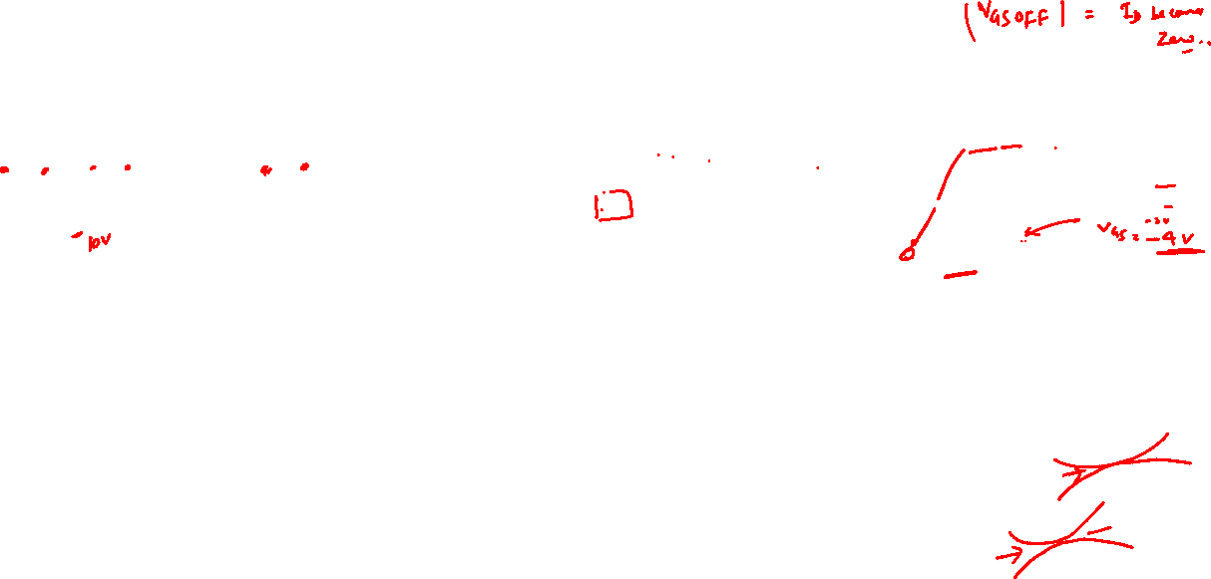

Slide 12
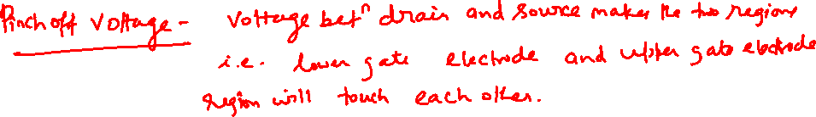

Slide 13
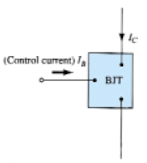
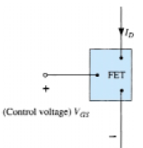
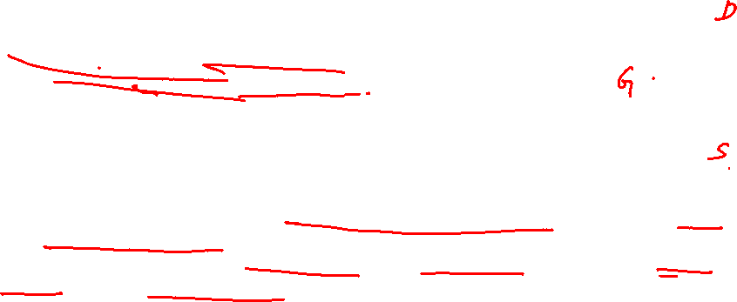
Junction Field-effect Transistor (JFET)
The field-effect transistor (FET) is a three-terminal device used for a variety of application just like BJT.
Although there are some important differences between the FET and BJT, together with many similarities.
The primary difference between the two types of transistors is the fact that
The BJT transistor is a current-controlled device, while the JFET transistor is a voltage-controlled device.
In other words, In BJT the current I_{C} is a direct function of the level of I_{B}.
For the FET the current I_{D} will be a function of the voltage V_{GS} applied to the input circuit
In each case the current of the output circuit is being controlled by a parameter of the input circuit—in one case a current level and in the other an applied voltage.
Field-effect transistor amplifiers provide an excellent voltage gain with the added feature of a high input impedance.
They are also considered low-power consumption configurations with good frequency range and minimal size and weight.
For FET ac equivalent model is somewhat simpler than that employed for BJTs.
The BJT had an amplification factor (beta), the FET has a transconductance factor, gm.

Slide 14
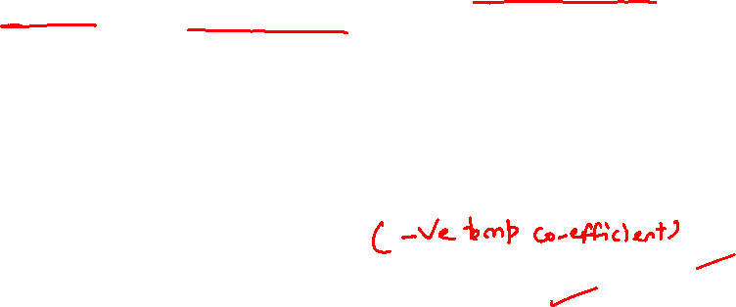
Comparison of BJT and FET
Just as there are npn and pnp bipolar transistors, there are n-channel and p-channel
field-effect transistors.
However, the BJT transistor is a bipolar device whereas the FET is a unipolar device depending solely on either electron (n-channel) or hole (p-channel) conduction.
For the FET an electric field is established by the charges present that will control the conduction path of the output circuit without the need for direct contact between the controlling and controlled quantities.
One of the most important characteristics of the FET is its high input impedance. At a level of 1MΩ to several hundred megohms. it far exceeds the typical input resistance levels of the BJT transistor configurations.
Although the BJT transistor has a much higher sensitivity to changes in the applied signal than FET.
In other words, the variation in output current is typically a great deal more for BJTs
than FETs for the same change in applied voltage.
For this reason, typical ac voltage gains for BJT amplifiers are a great deal more than for FETs.
FETs are more temperature stable than BJTs
FETs are usually smaller in construction and easy to fabricate in IC than BJTs,
So FET’s are particularly useful in integrated-circuit (IC) chips.
There are two types of FETs:
JFETs and
MOSFETs

Slide 15
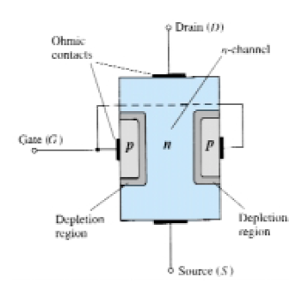

BASIC CONSTRUCTION OF THE N-CHANNEL JFET
The basic construction of the n-channel JFET is shown in Fig.
The major part of the structure is the n-type material (referred as substrate)
within substrate a channel of majority charge carrier, electron forms between the embedded layers of p-type material
FET is a three terminal device (Source S, Drain D, Gate G)
In RHS Figure the top of the n-type channel is connected through an ohmic contact to a terminal referred to as the drain (D)
while the lower end of the same material is connected through an ohmic contact to a terminal referred to as
the source (S).
The two embedded p-type materials are connected toge-ther and to the an ohmic contact referred to as gate (G) terminal.
Therefore, the drain and source are connected to the ends of the n-type channel and the gate to the two layers of p-type material.

Slide 16

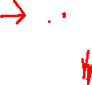
CHARACTERISTICS OF JFETs
As shown in Prev. fig, in the absence of any applied potentials the JFET has two p-n junctions under no-bias conditions.
The result is a depletion region at each junction that resembles the same region of a diode under no-bias conditions.
Recall also that a depletion region is that region void of free carriers and therefore unable to support conduction through the region.
the water analogy of Fig RHS is appropriate and does provide a sense for the JFET control at the gate terminal and the appropriateness of the terminology applied to the terminals of the device.
The source of water pressure can be likened to the applied voltage from drain to source that will establish a flow of water (electrons) from the spigot (source).
The “gate,” through an applied signal (potential), controls the flow of water (charge) to the “drain.”
The drain and source terminals are at opposite ends of the n-channel as introduced in Prev. Fig. because the terminology is defined for electron flow.

Slide 17
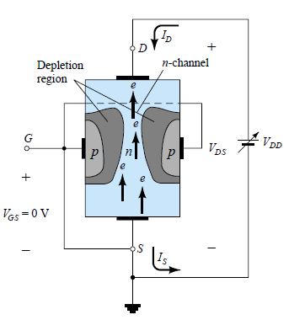
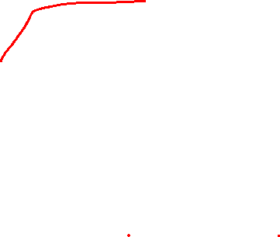
JFET CHARACTERISTICS
V_{GS} = 0 V,
(i) V_{DS} Some Positive Value
In Fig., a positive voltage V_{DS} has been applied across the channel and
gate has been connected directly to the source to establish the condition V_{GS} = 0 V.
The result is a gate and source terminal at the same potential and
a depletion region exists in the low end of each p-material similar to the distribution of the no-bias conditions of Fig.
(ii) The instant the Drain voltage V_{DD} ( V_{DS}) is applied: The electrons will be drawn to the drain terminal, establishing the conventional current I_{D} with the defined direction of Fig
The path of charge flow clearly reveals that the drain and source currents are equivalent (I_{D} = I_{S}). Under the conditions appearing in Fig. RHS,
the flow of charge is relatively uninhibited and limited solely by the resistance of the n-channel between drain and source.
Construction and Characteristics of JFETs

Slide 18
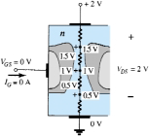
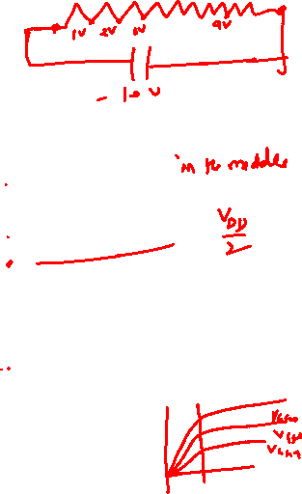
It is important to note that the depletion region is wider near the top of both p type materials.
To understand the reason for the change in width of the depletion region
Assuming a uniform resistance in the n-channel, the resistance of the channel can be broken down to the divisions appearing in Fig.
The current I_{D} will establish the voltage levels through the channel as indicated in the figure.
The result is that the upper region of the p-type material will be reverse biased by about 1.5 V, with the lower region only reverse-biased by 0.5 V.
(iii) Greater the applied reverse bias: The wider the depletion region—hence the distribution of the depletion region as shown in Fig.
The fact that the p-n junction is reverse-biased for the
length of the channel results in a gate current of zero amperes as shown in the same figure.
Fact that I_{G} = 0 A is an important characteristic of the JFET.
As the voltage V_{DS} is increased from 0 to a few volts: the current will increase as determined by Ohm’s law and the plot I_{D} versus V_{DS} is shown in RHS
The relative straightness of the plot reveals that for the region of low values of V_{DS}, the resistance is essentially constant.
As V_{DS} increases and approaches a level referred to as V_{P} in plot the depletion regions
will widen ➔ causing a noticeable reduction in the channel width.
The reduced path of conduction causes the resistance to increase.

Slide 19
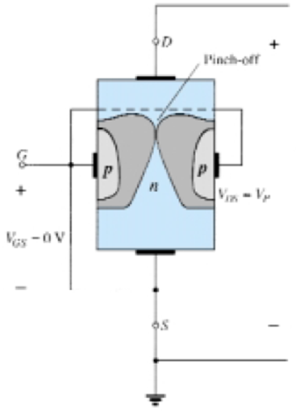
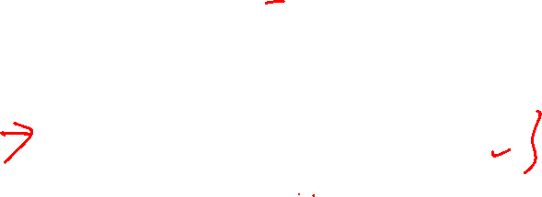
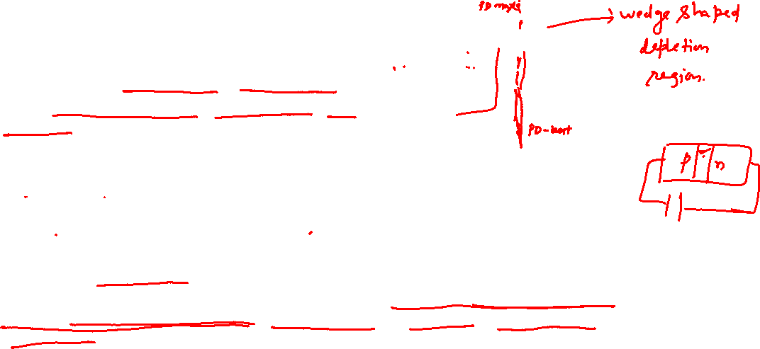
The more horizontal the curve, the higher the resistance, suggesting that the resistance is approaching “infinite” ohms in the horizontal region.
If V_{DS} is increased to a level where it appears that the two depletion regions would “touch” as shown in Fig. a condition referred to as pinch-off will result.
The level of V_{DS} that establishes this condition is referred to as the pinch-off voltage and is denoted by V_{P}
In actuality, the term pinch-off is a misnomer in that it suggests the current I_{D} is pinched off and drops to 0 A As shown in Fig.
however, this is hardly the case— actually at and after pinch off I_{D} maintains a saturation level defined as I_{DSS} in Fig.
In reality a very small channel still exists at and after
pinch off with a current of very high density.
This fact that I_{D} does not drop off at pinch-off and
maintains the saturation level is verified by the following fact:
➔The absence of a drain current would remove the possibility of different potential levels through the n-channel material to establish the varying levels of reverse bias along the p-n junction.
➔ The result would be a loss of the depletion region distribution that caused pinch-off

Slide 20
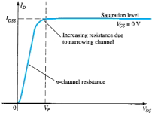
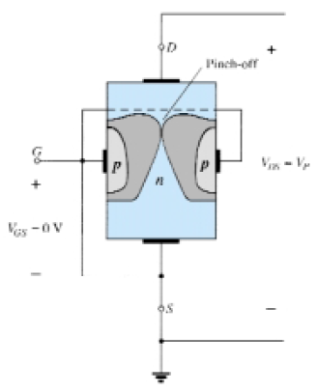
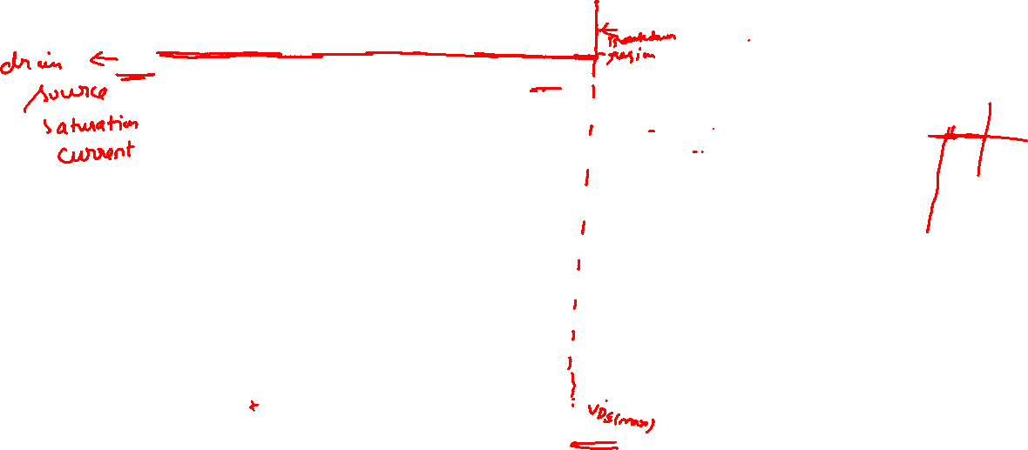
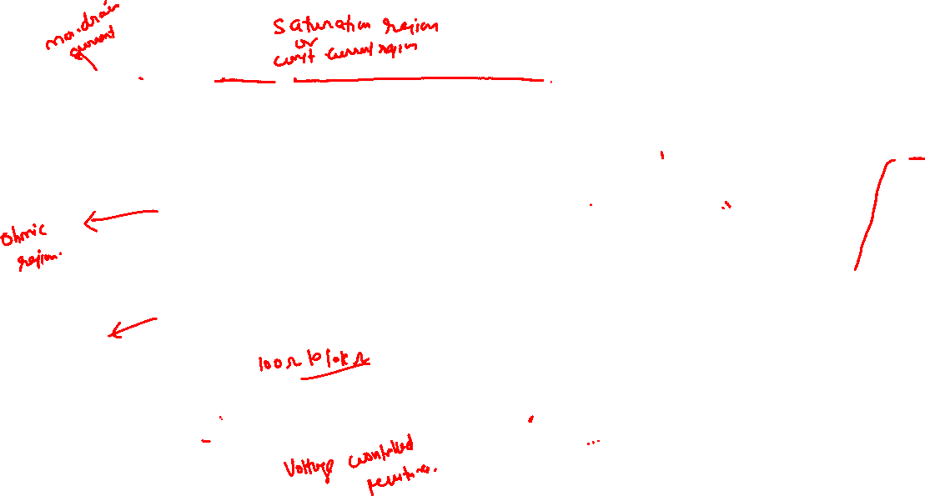
JFET CHARACTERISTICS: V_{GS} = 0

Slide 21

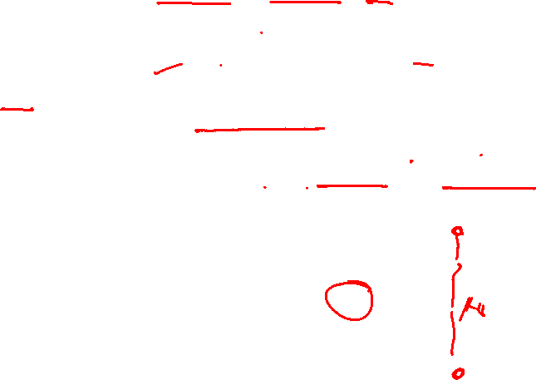
As V_{DS} is increased beyond V_{P} ,
the “close channel region” encounter between the two depletion regions will increase in length along the channel,
but the level of I_{D} remains essentially the same.
In essence, therefore, once V_{DS} > V_{P} the JFET has the characteristic of a current source.
the current is fixed at I_{D} = I_{DSS}, but the voltage V_{DS} (for levels V_{P}) is determined by the applied load.
I_{DSS} term is derived from the fact that it is the Drain-to-Source current with a Short-circuit connection from gate to source.
I_{DSS} is the maximum drain current for a JFET and is defined
by the conditions V_{GS} > 0 V and V_{DS} > |V_{P}|.

Slide 22
V_{GS} < 0 V: The voltage from gate to source, V_{GS} is the Controlling Voltage of the JFET.
Family of curves of I_{D} - V_{DS} for various levels of V_{GS} can be obtained for the JFET, just as for the BJT for I_{C} versus V_{CE} for different levels of I_{B} obtained for the BJT .
For the n-channel device the controlling voltage V_{GS} is made more and more negative from its V_{GS} = 0 V level. Means gate terminal will be set at lower & lower potential levels as compared to source
In Fig. negative voltage of -1 V has been applied between the gate and source terminals for a low level of V_{DS}. 33
The effect of the applied negative-bias V_{GS} is to establish depletion regions similar to those obtained with V_{GS} = 0 V but at lower levels of V_{DS}.
The result of applying a negative bias to the gate is
to reach the saturation level at a lower level of V_{DS} as shown in Fig. for V_{GS}= 1 V.
The resulting saturation level for I_{D} has been reduced
And will continue to decrease as V_{GS} is made more and more negative.
The pinch-off voltage continues to drop in a parabolic manner as V_{GS} becomes more and more negative.
When V_{GS}= - V_{P} it will be sufficiently negative to establish a saturation level that is essentially 0 and
In this case for all practical purposes the device has been “turned off.”

Slide 23
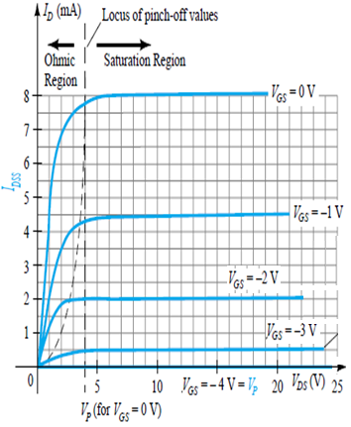
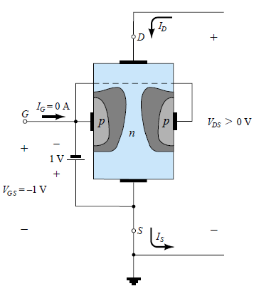
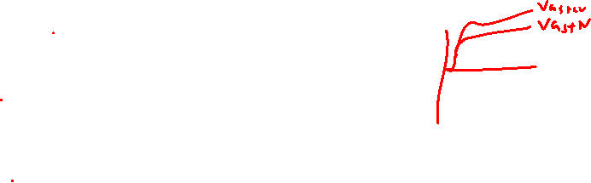
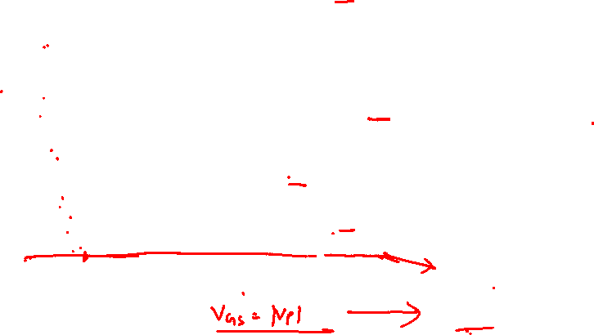
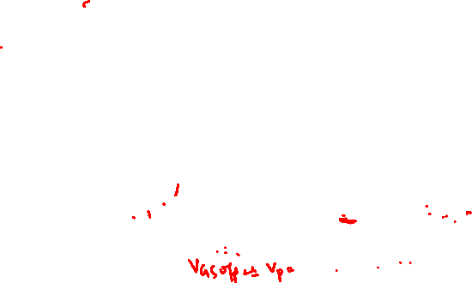
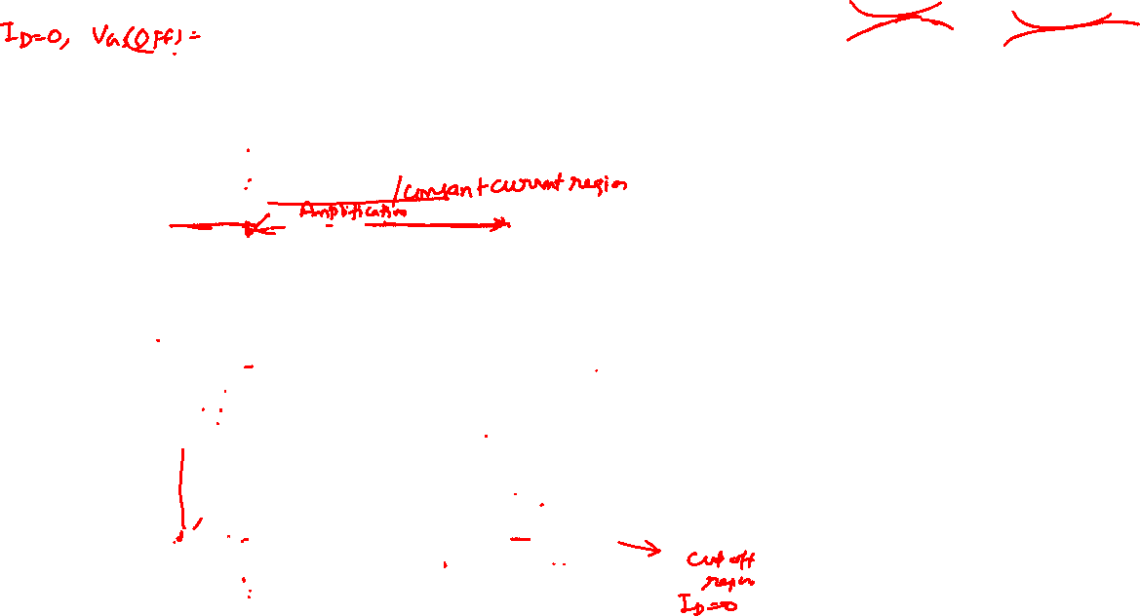
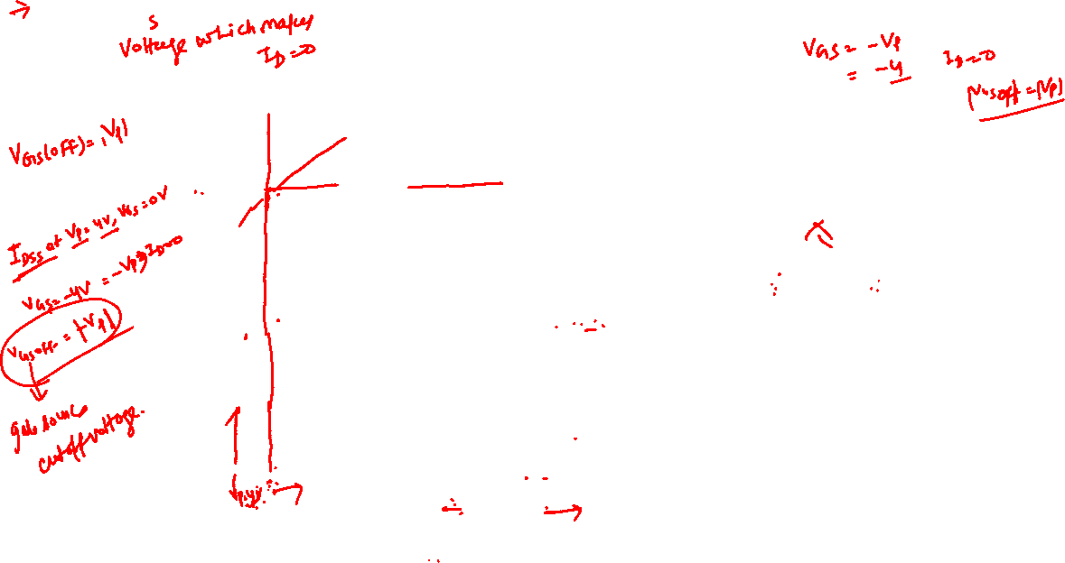
JFET CHARACTERISTICS: V_{GS} < 0

Slide 24
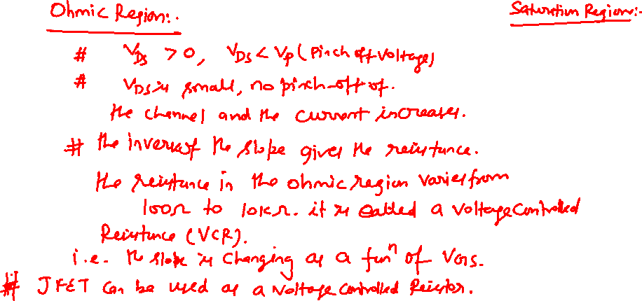


The level of V_{GS} that results in I_{D} = 0 mA is defined by V_{GS} = V_{P}, with V_{P} being a
negative voltage for n-channel devices and a positive voltage for p-channel JFETs.
On most specification sheets the pinch-off voltage is specified as V_{GS}(off) rather than V_{P}.
The region to the right of the pinch-off locus is the region typically employed in linear amplifiers (amplifiers with minimum distortion of the applied signal) and is commonly referred to as the constant-current, saturation, or linear amplification region.

Slide 25

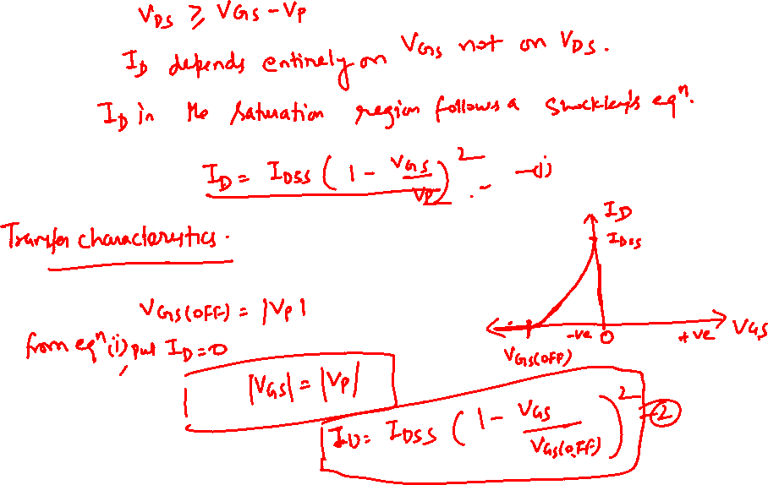

Slide 26
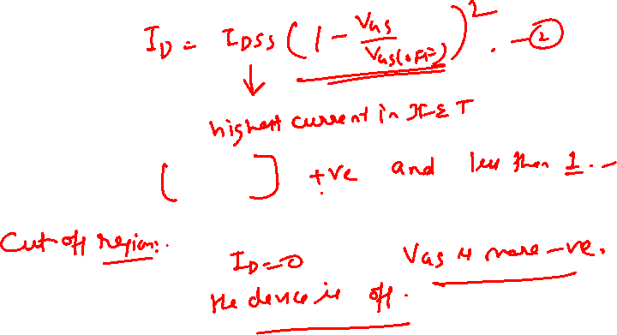

Slide 27
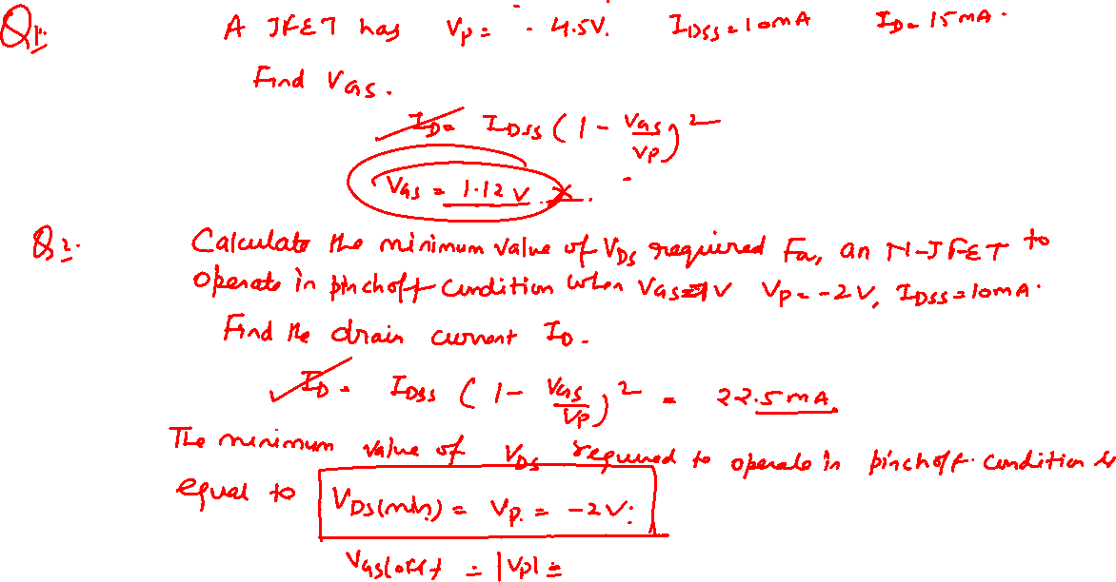

Slide 28
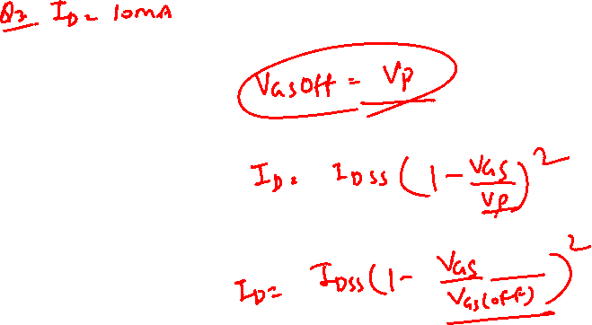

Slide 29
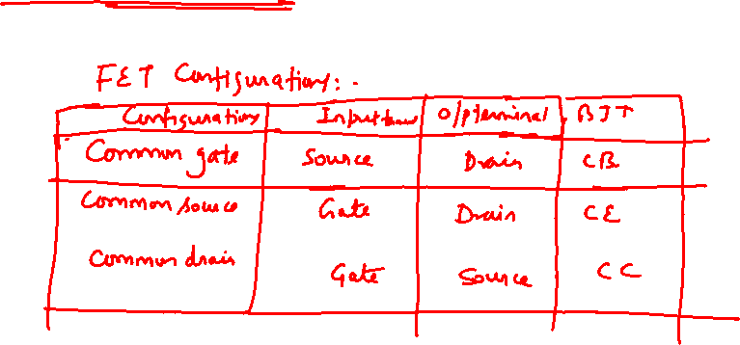

Slide 30
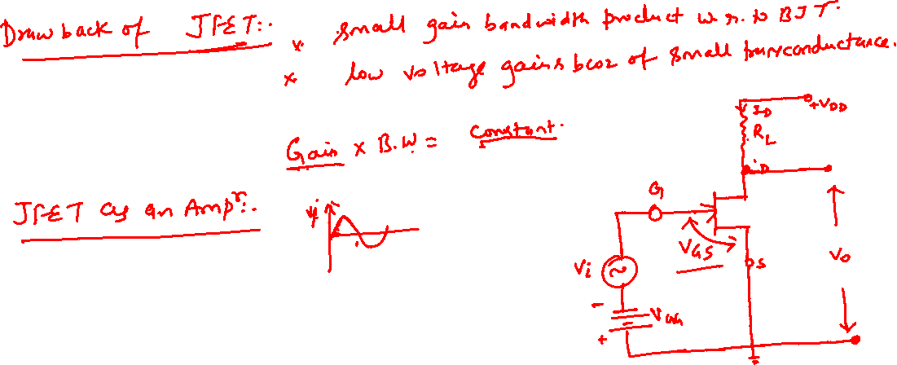

Slide 31


VOLTAGE-CONTROLLED RESISTOR
The region to the left of the pinch-off locus of is referred to as the ohmic or voltage-controlled resistance region.
In this region the JFET can actually be employed as a variable resistor (possibly for an automatic gain control system) .
Whose resistance is controlled by the applied gate-to-source voltage.
The slope of each curve and therefore the resistance of the device between drain and source for V_{DS} < V_{P} is a function of the applied voltage V_{GS.}
As V_{GS} becomes more and more negative,
the slope of each curve becomes more and more horizontal, corresponding with an increasing resistance level.
The following equation will provide a good first approximation to the resistance level in terms of the applied voltage V_{GS}.
Where
r_{o} is the resistance with V_{GS} = 0 V and r_{d} the resistance at a particular level of V_{GS}.
For an n-channel JFET with r_{o} equal to 10 kΩ (V_{GS} = 0 V, V_{P} =6 V), r_{d} = 40k Ω at V_{GS} =3 V.

Slide 32
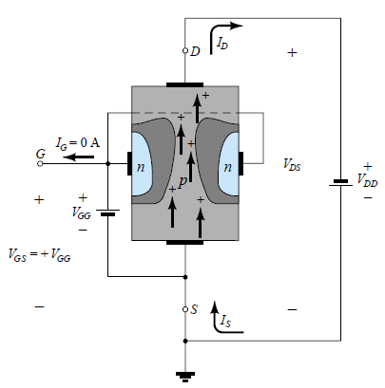
P-CHANNEL JFET DEVICES
The p-channel JFET is constructed in exactly the same manner as the n-channel device of Fig., but with a reversal of the p- and n-type materials as shown in Fig.
The defined current directions are reversed, as are the actual polarities for the voltages V_{GS} and V_{DS}.
For the p-channel device, the channel will be constricted by increasing positive voltages from gate to source and
V_{DS} will result in negative voltages on the characteristics of Fig shown in next slide.
Which has an I_{DSS} of 6 mA and a pinch-off voltage of V_{GS} = +6 V.
Minus signs for V_{DS} simply indicate that the source is at a higher potential than the drain.
Note at high levels of V_{DS ,} the curves suddenly rise to levels that seem unbounded.
The vertical rise is an indication that breakdown has occurred and
the current through the channel is now limited solely by the external circuit.
Although not appearing in Fig. for the n-channel device, they do occur for the n-channel device if sufficient voltage is applied.
This region can be avoided if the level of VDS_{max} is noted on the specificationsheet and
The design is such that the actual level of V_{DS} is less than this value for all values of V_{GS}.

Slide 33
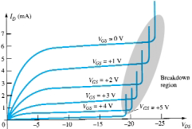
Charcteristic curve for P-CHANNEL JFET Devices

Slide 34
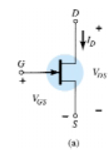
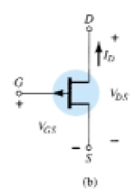
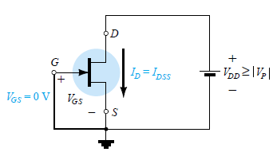



JFET SYMBOLS
n-channel
The graphic symbols for the n-channel and p-channel JFETs are provided in Fig. RHS
The arrow is pointing in for the n-channel device of Fig. a to represent the direction in which I_{G} would flow if the p-n junction were forward-biased.
For the p-channel device (Fig.b) the only difference in the symbol is the direction of the arrow.
Important Points:-
The maximum current is defined as I_{DSS} and occurs when V_{GS} = 0 V and V_{DS} ≥ |V_{P}| as shown in Fig. a.
For gate-to-source voltages V_{GS} less than (more negative than) the pinch-off level, the drain current I_{D} = 0 A FET is cutoff Fig. b
For all levels of V_{GS} between 0 V and the pinch-off level, the current I_{D} will range between I_{DSS} and 0 A, respectively, Fig. c
For p-channel JFETs a similar list can be developed.
Fig. a
Fig. b
Fig. c

Slide 35


TRANSFER CHARACTERISTICS OF JFET
In BJT, a linear relationship exists between I_{C} and I_{B}. output current I_{C} and input controlling current I_{B} were related by beta.
But unfortunately, this linear relationship does not exist between the output and input quantities of a JFET.
The relationship between I_{D} and V_{GS} in JFET is defined by Shockley’s equation:
The squared term of the equation will result in a nonlinear relationship between I_{D} and V_{GS}
Above equation produce a curve that grows exponentially with decreasing magnitudes of V_{GS}.
a graphical rather than mathematical approach will in general be more direct and easier to apply.
The graphical approach, however, will require i)a plot of above Eq. to represent the device and a ii) plot of the network equation relating the same variables.
The solution is defined by the point of intersection of the two curves.
It is important to keep in mind when applying the graphical approach that the device characteristics will be unaffected by the network in which the device is employed.
The network equation may change along with the intersection between the two curves, but the transfer curve defined by Eq. is unaffected.

Slide 36


Transfer curve (obtained using Shockley’s equation)
When V_{GS} = 0 V, I_{D} = I_{DSS}.
When V_{GS} = V_{P} ➔ I_{D} = 0 mA.
In Fig. two graphs are provided, with the vertical scaling in millamperes for each graph.
One is a plot of I_{D} versus V_{DS}, while the other is I_{D} versus V_{GS}.
Using the drain characteristics on the right of the “y” axis, a horizontal line can be drawn from the saturation region of the curve denoted V_{GS} =0 V to the I_{D} axis.
The resulting current level for both graphs is I_{DSS}.
The point of intersection on the I_{D} versus V_{GS} curve will be as shown since the vertical axis is defined as V_{GS} = 0 V.

Slide 37
The transfer characteristics are a plot of an output (or drain) current versus an input-controlling quantity.
There is therefore a direct “transfer” from input to output variables when employing
the curve to the left of prev. plot.
If the relationship were linear, the plot of I_{D} versus V_{GS} would result in a straight line between I_{DSS} and V_{P}.
However, a parabolic curve will result because the vertical spacing between steps of V_{GS} on the drain characteristics of Fig. decreases noticeably as V_{GS} becomes more and more negative.
Compare spacing between V_{GS} = 0 V and V_{GS} = 1 V to that between V_{GS}=3 V and pinch-off. The change in V_{GS} is the same, but the resulting change in I_{D} is quite different

